Slide 1

Final Project Reinforcement Models for Games and Simulations
Smith, Travis
CSCI E-89 Deep Learning, Spring 2020
Harvard University Extension School
Prof. Zoran B. Djordjević
@Travis Smith

Slide 2
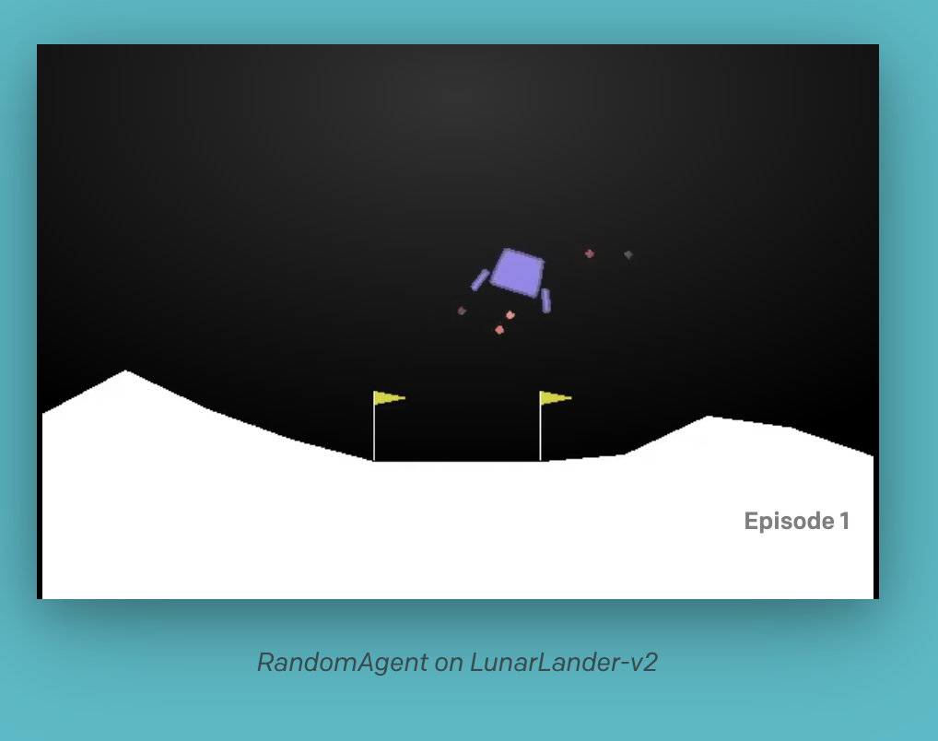
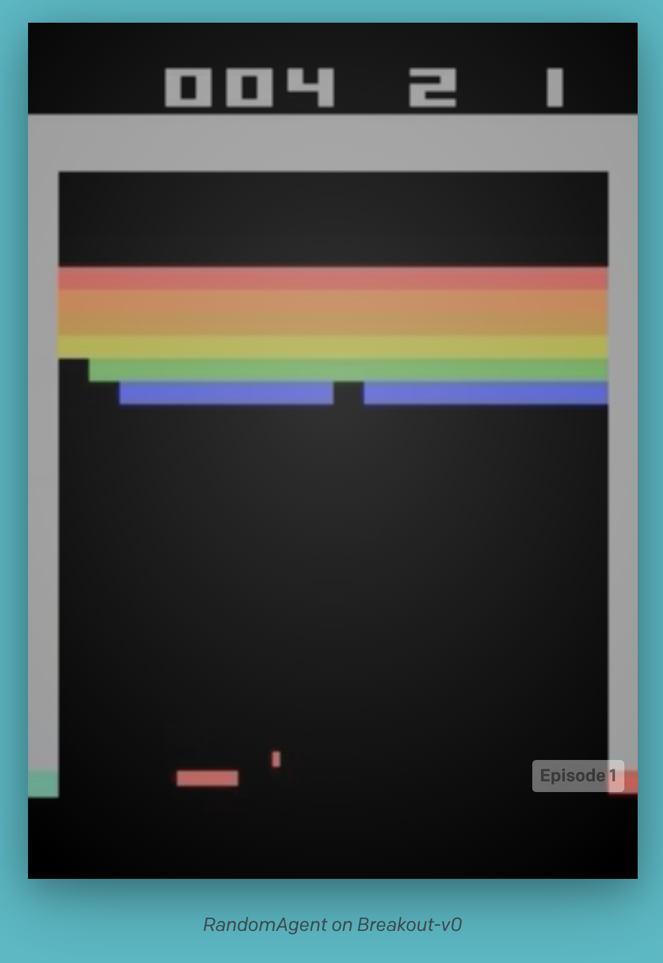
Exploring Game AI with Reinforcement Learning
How might we train a neural network to play a game? What sort of approaches are available to us, and how might deep learning networks fit into those paradigms?
Reinforcement learning predates modern deep learning and in some ways forms its own field of literature outside of supervised/unsupervised learning paradigms. But thanks to research in the last decade, we now have powerful techniques that synthesize deep learning and older reinforcement learning practices.
In this project we’ll show how to approach two canonical deep RL benchmark games: OpenAI Gym’s Lunar Lander and Atari Breakout.
To start, however, we’ll need to explore a number of reinforcement learning concepts— a background in supervised deep learning is not enough to understand how these agents work!
@Travis Smith

Slide 3
What is RL?
Reinforcement Learning (RL) is a field of machine learning that forms a “third paradigm,” alongside supervised and unsupervised learning.
Many of its insights come from neighboring disciplines, such as control theory (from which the Bellman equation is borrowed).
Fundamentally, RL is about training an agent to perform a task, often in non-deterministic settings with partial information (where optimal agent behavior can’t be directly calculated).
Exciting applications: Robots! and Board & Video Game AI!
@Travis Smith

Slide 4
Agents and Environments
Reinforcement learning is about training an agent to maximize reward in a given environment.
To do this, the agent-environment interaction is generally modeled using the following:
Policy — A mapping from states in the environment to actions the agent will take.
Reward Signal — The numeric value of transitioning to one state from another, or of taking an action in a given state.
Value Function — This is what reinforcement models converge on directly, allowing us to determine the expected value of a next state or an action (given a state).

Slide 5
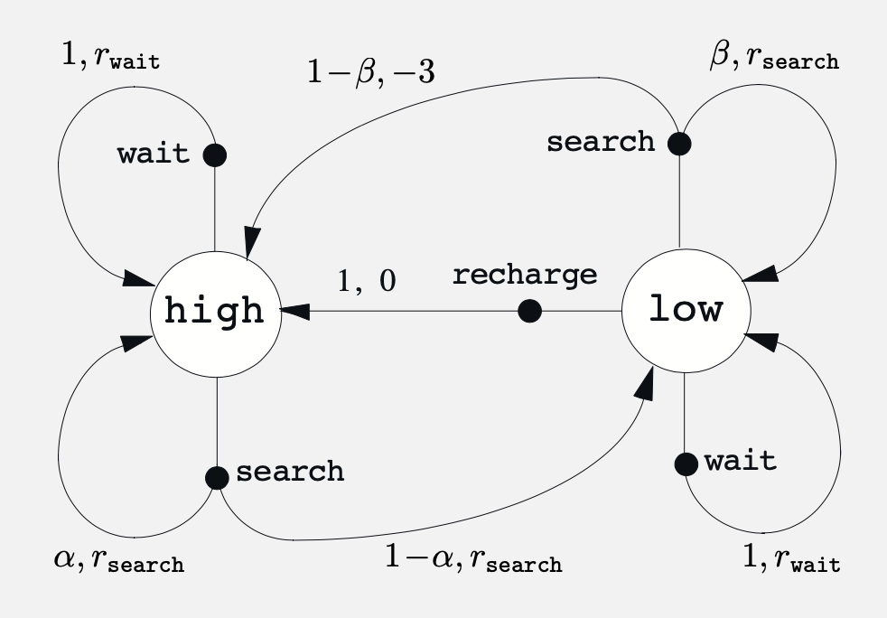
Value Functions
Reinforcement learning algorithms generally derive value functions, which are used to learn the best actions an agent can take (i.e. used to determine the policy).
Consider the diagram to the left, showing two states and a variety of different actions a robot can take in those states.
How do we know which action is best? Reward will tell us which action gives the best immediate result, but we want to take the action with the highest long term value.
We need to learn the values of actions and states!
Deep reinforcement learning methods use neural networks as function approximators w.r.t. to value functions!

Slide 6
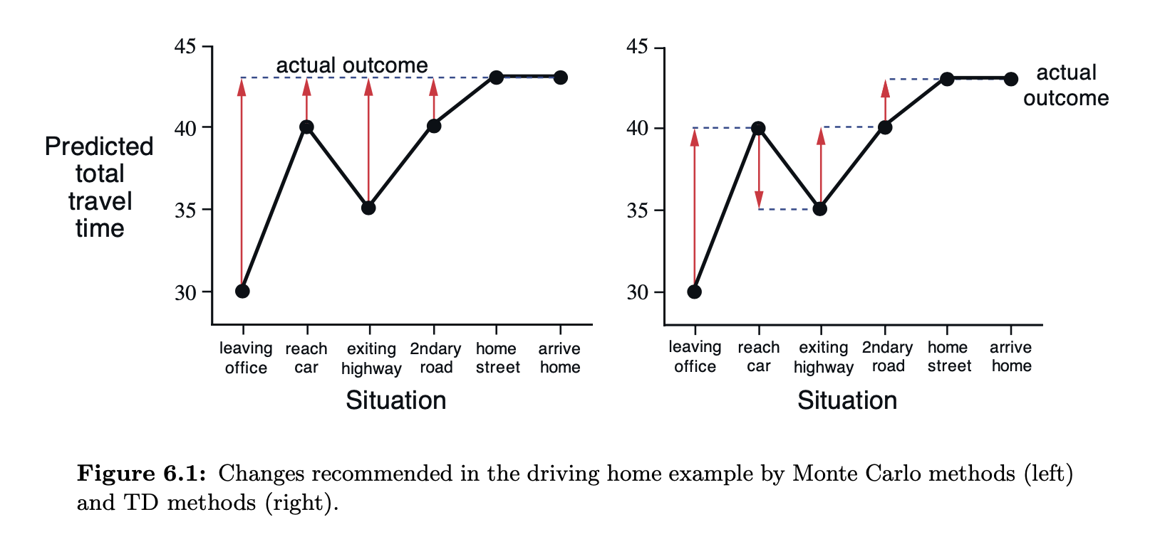
Learning!
There are, of course, learning techniques that don’t involve directly calculating value functions, but value function techniques are very popular and very effective for a variety of tasks.
How do we learn the value functions?
Dynamic Programming — We could try directly computing them. This is computationally impossible for even slightly complicated problems.
Monte Carlo Methods — We could try sampling. For difficult tasks, convergence is very slow.
Temporal Difference (TD) Methods — We sample a path through an episode, but rather than update after a complete episode (Monte Carlo), we update at each step.

Slide 7
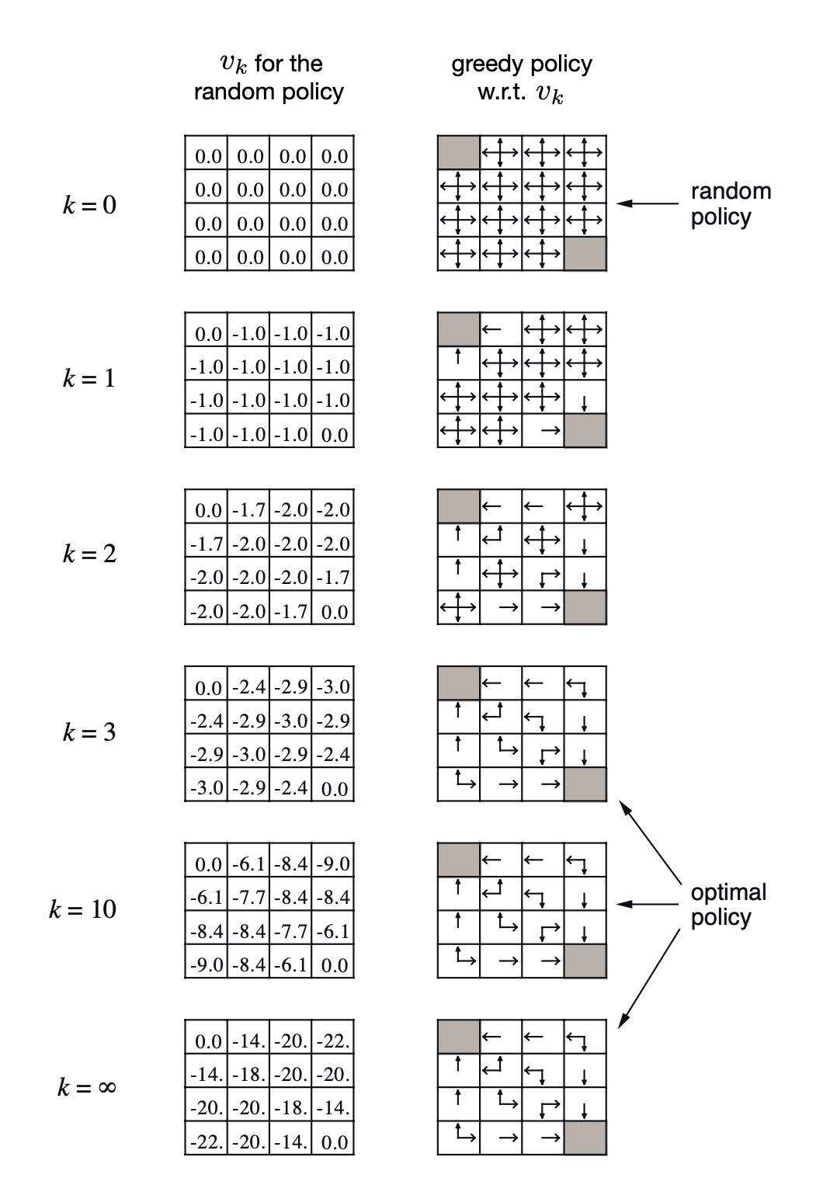
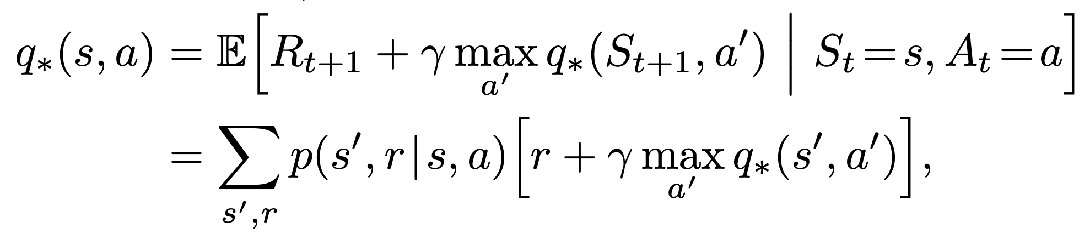
Dynamic Programming
Like in the (probably more familiar) computer-science sense of the term, we perform tabular, recursive calculations to determine the value at each individual state.
In fact, the term was originally coined in the context of control theory, and is directly applicable to reinforcement learning problems in its original sense!
DP is, however, prohibitively expensive, even for what seem like relatively small problems.
More technically, with DP we’re computing the Bellman optimality equation, fundamental to all contemporary reinforcement learning techniques:

Slide 8
Monte Carlo Methods
Monte Carlo methods involve completing entire episodes of the training task, then averaging rewards for states across those episodes (an episode can be thought of as a “game” for our purposes).
Unlike DP, they don’t require us to know anything about the environment! We’re just sampling.
Monte Carlo is much less computationally expensive than DP, and very complex tasks can be simulated, but it can take many, many simulations to arrive at an optimal solution.
Nor is convergence even guaranteed when using Monte Carlo! (some TD approaches share this problem)

Slide 9
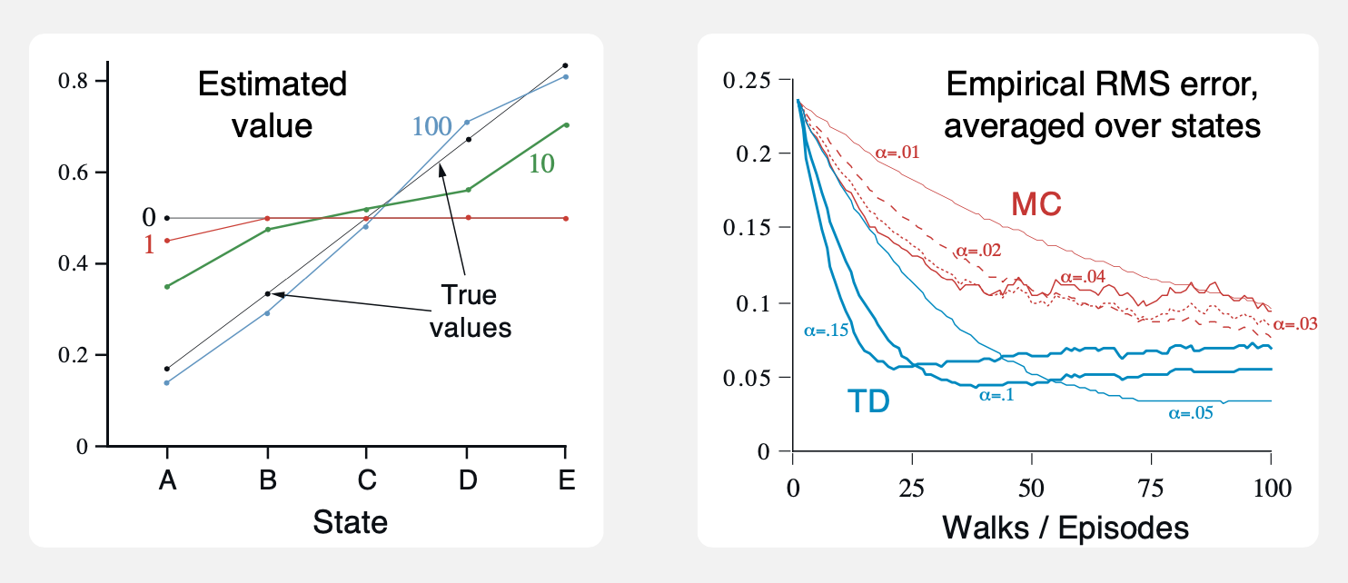
Temporal Difference (TD) Methods
Temporal Difference methods might be thought of as an optimal middle-ground between both dynamic programming and MC methods — they use the Bellman equation, like DP, and sample episodes, like MC (they don’t need to know anything about the environment either).
But they’re much more efficient than Monte Carlo methods!
For this reason, TD is the most commonly used approach to practical reinforcement learning, and most deep learning RL methodology is built on TD algorithms.

Slide 10
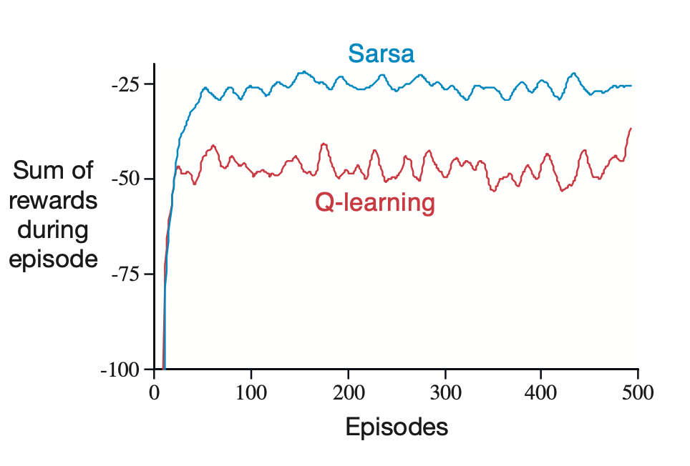
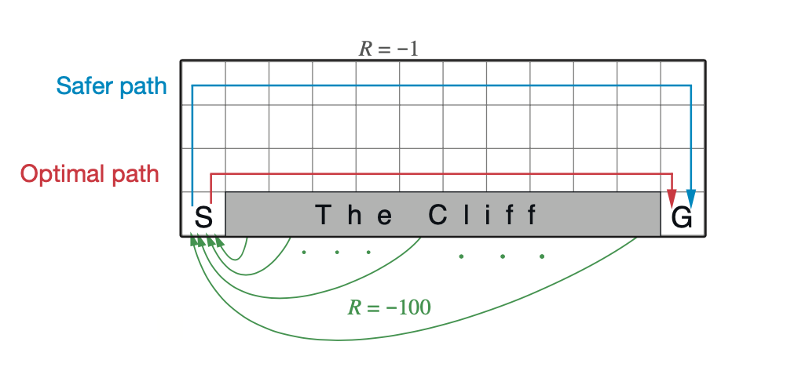
More About TD Methods
TD methods come in a variety of flavors — the most commonly used are Sarsa, Q-learning, and Expected Sarsa.
Sarsa methods are considered on-policy while Q-learning is off-policy.
Additional differences between these are beyond the scope of this short intro, but it’s worth understanding that there’s a wide variety of methods and a wide variety of optimizations for each.
Of interest to us here is Q-learning, as it forms the basis for a very common deep-reinforcement learning approach: deep Q-learning.

Slide 11
Exploration - Exploitation
One fundamental — and rather intuitive — issue that we face with sampling methods (both MC and TD) is that we want our agent to learn the best possible “routes” through the action space, but we don’t want the agent to get stuck in any local value maxima.
What we’d like is for our agent to generally stick close to a path that seems optimal, but to sometimes explore outside of this range.
This is called the exploration vs. exploitation trade-off, and we’ll see that our deep learning agents need hyperparameters that allow us to control this.

Slide 12
Deep Q-Learning
Our approach to TD learning above was tabular — like with dynamic programming, our representation of our value function would have been something like a big table, with rows for states and actions for columns (this is of course something of a simplification).
Rather than calculating tables with discrete values, deep learning gives us a way to approximate the state-value function (Q) by updating parameters in a neural network. In this sense, deep Q-learning is really an approximate reinforcement learning method.
But it’s not as simple as swapping the table for the NN. The network requires some optimizations to guarantee convergence, namely:
Epsilon Annealing
Double Learning
Experience Replay

Slide 13
DQN Optimizations
Epsilon Annealing — We want our agent to do a lot of exploring at first, then gradually settle near an optimal route as time goes on. To do this, we reduce the epsilon (explore-exploit hyperparameter) over time.
Double Learning — Mathematically, using a single network to calculate loss between time steps is problematic. In practice, we almost always prefer two networks, one updating less frequently than the other (this is called double Q-learning).
Experience Replay — Historically, in reinforcement learning research, stochastic gradient descent was considered a non-starter. This is because immediately updating NN parameters for actions as you take them (like tabular Q-learning does) does not work! A major breakthrough in deep Q-learning was the development of “replay buffers,” which store action results. We then update our network using samples from the replay buffer.

Slide 14
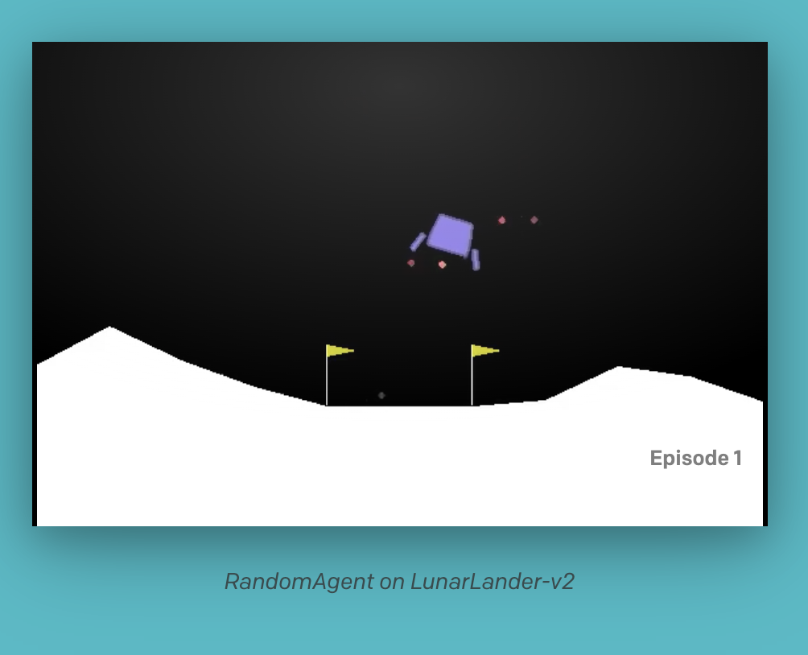
Lunar Lander
So I’m sure that was a whirlwind, but now we theoretically have enough background to build our first deep Q-learning network!
Let’s build our first AI agent, for a game called Lunar Lander. The environment for this game is provided by OpenAI Gym (https://gym.openai.com/), a popular package for benchmark RL environments.
Lunar Lander is (I believe) based on an old Atari arcade game, where you’re tasked with landing a lunar module in a designated spot. OpenAI’s implementation uses a 2D space with four possible actions.
The ship must land between the two yellow flags to receive the maximum reward. At any given timestep it can shoot particles left, right, or down, or choose not to shoot any particles at all.
We’re going to build a pretty standard deep Q-learning agent using all the tools we learned about in the previous slides!

Slide 15
Lunar Lander — Parts
So, to recap, we need a few things:
Environment — This is provided by OpenAI Gym, and includes the reward signal our agent will receive while performing actions in the environment.
Agent — Building the agent is our primary goal, but it consists of a number of moving parts, as we’ve seen. We need the following:
Neural Network — We of course need our primary network as our value-function approximator.
Target Network — Generally, for double Q-learning, we need a second network, but for the Lunar Lander agent we just copy our first neural network and calculate loss with the copy. For harder problems, you really need a second network.
Replay Buffer — Crucially, we need a replay buffer to store all recently taken actions. We’ll sample from these randomly to train our primary network.
Train/Test Scripts — Lastly, we of course need our training and testing scripts. These will perform the training loops and play the game.

Slide 16
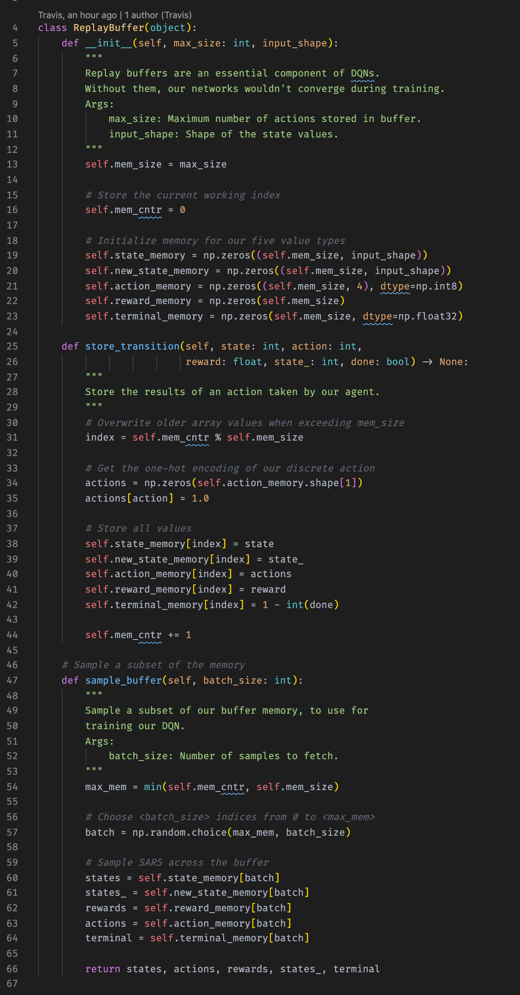
Lunar Lander — Replay Buffer
Quick note: the code for this project is changing rapidly. I’m trying to keep these slides as up to date as possible, but please check the repo (or .zip) for the most up-to-date packages.
Building our replay buffer is pretty straightforward: it’s really just a big list of recent actions and their outcomes.
In order to calculate loss and perform SGD, our replay buffer needs to store the following values: state, next state, reward, action, and whether the action ended the game (the terminal flag).
We then need to be able to sample batches from the buffer.

Slide 17
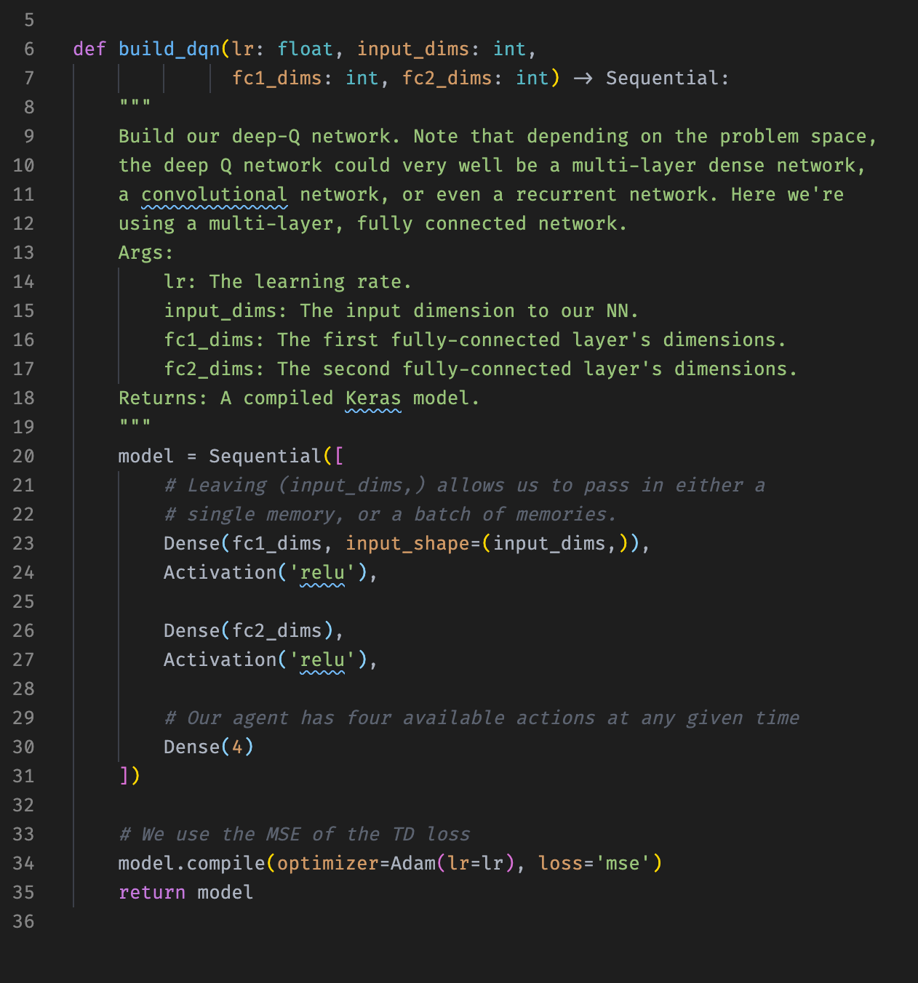
Lunar Lander — DQN
This is again pretty straightforward. More optimized deep Q-learning networks can have some unusual features, but we’re using a simple, fully-connected network for this task.
Our input shape is the state of the environment, and our output shape (the output of the final dense layer) is the number of actions our agent can take, which is always four.
We’ve trained our network with 256 nodes in the first dense layer and 128 in the second. Because these networks are very slow to train, testing other network sizes was prohibitive. These sizes worked quite well for us nonetheless.
If we were to really optimize this agent, we should try other network structures in addition to different layer sizes.

Slide 18
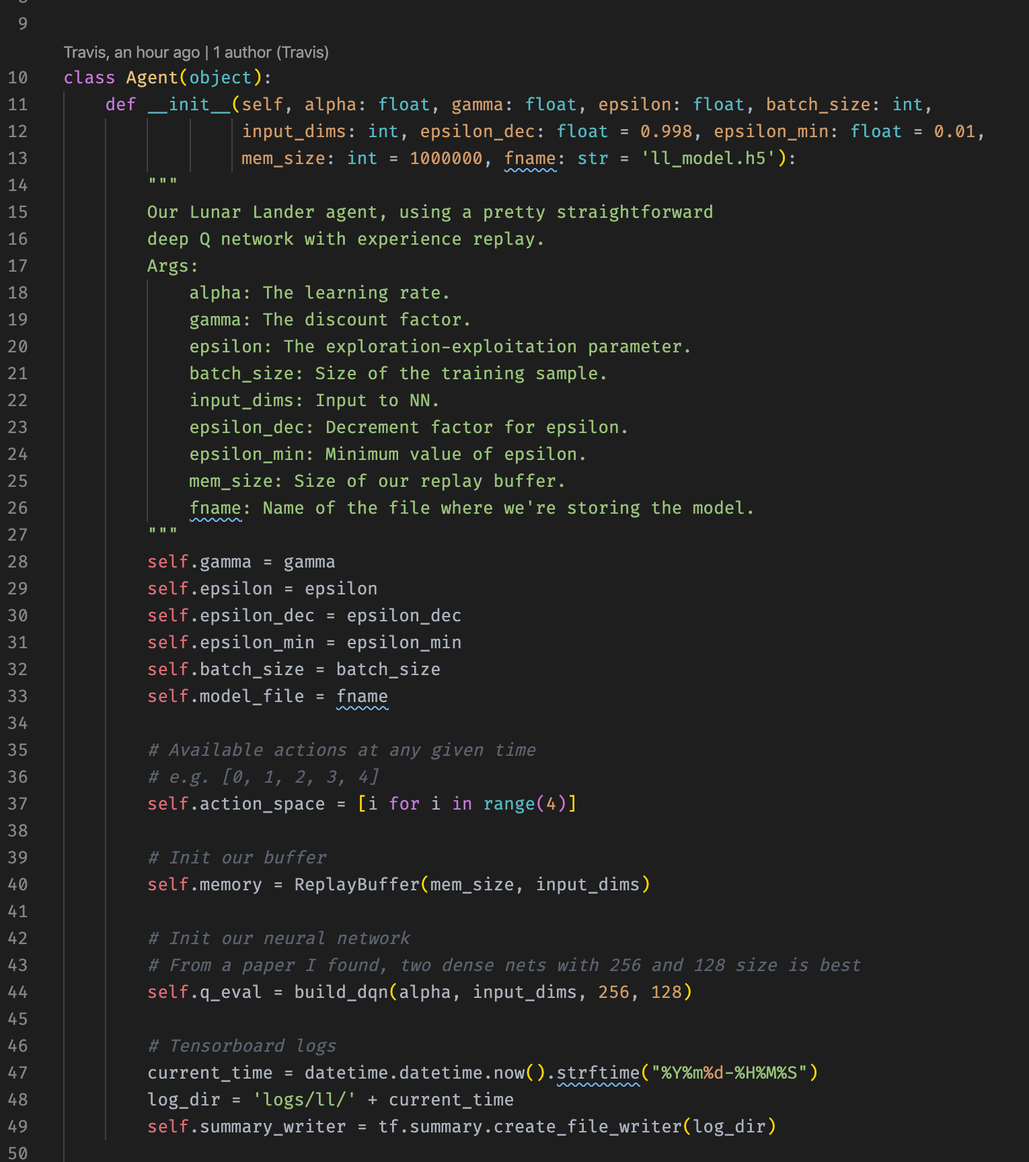
Lunar Lander — Agent
So, our agent wraps everything together: it builds the neural networks, creates the replay buffer, and then manages interactions with the environment.
Here you can see how our epsilon value, the exploit-explore hyperparameter, has a start value, a decrement value, and a minimum value. These are essential for epsilon annealing.
Additionally, while we haven’t discussed it before, the gamma value describes the “discount rate” of future actions. This is fundamental when calculating the Bellman equations, and, consequently, the TD loss.
Finally, we have some logging utilities.
Now let’s walk through the methods that the agent class implements.

Slide 19
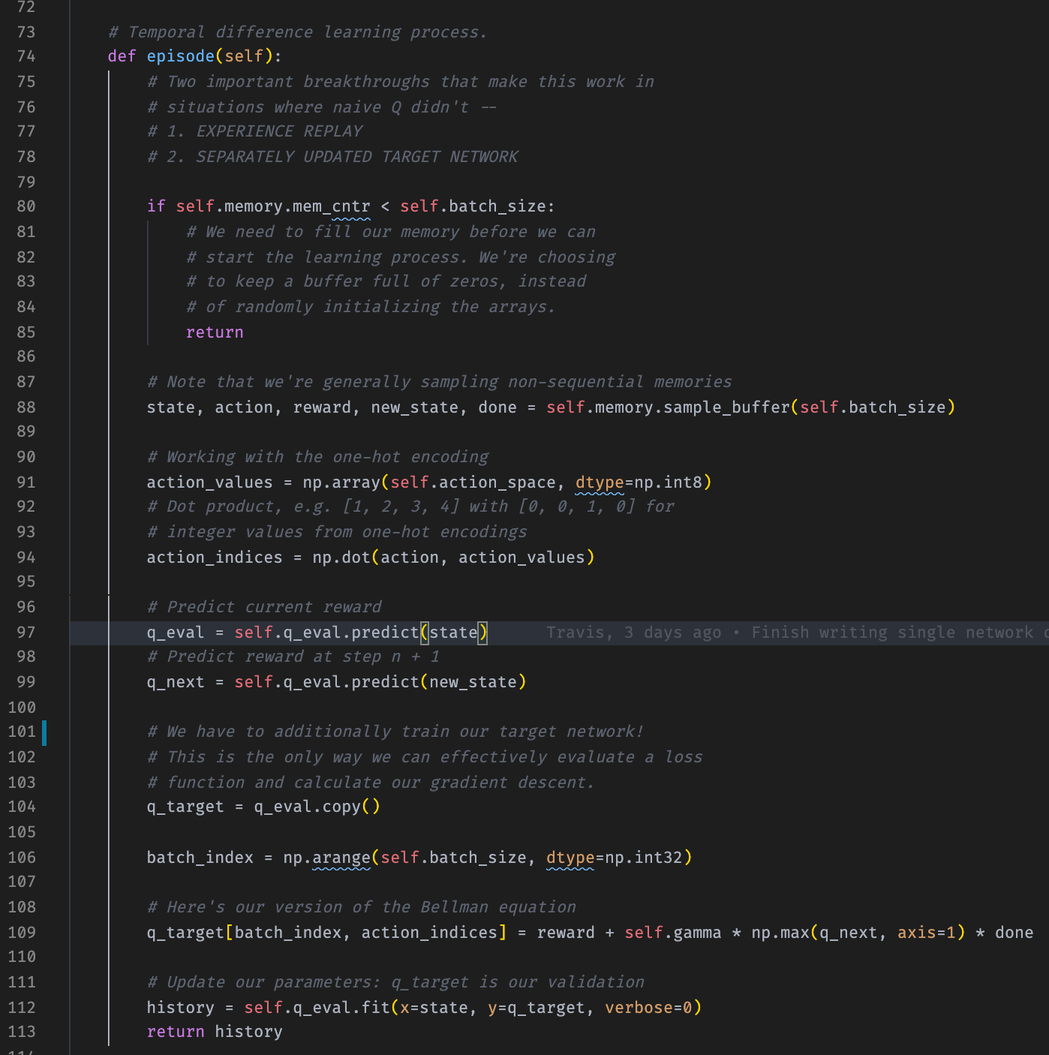
Lunar Lander — Agent
This method is at the heart of the model training process.
As described earlier, you can see that it:
1. Samples the buffer.
2. Makes predictions using our primary network.
3. Evaluates the loss between our primary network and our target network (double learning).
4. Updates our primary network according to the loss.
Note at the top that it doesn’t do any of this if the buffer isn’t sufficiently large!

Slide 20
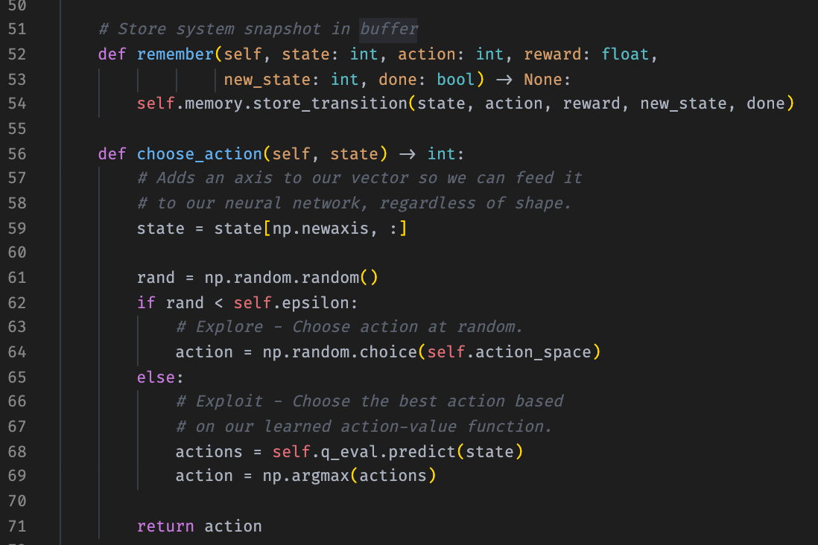
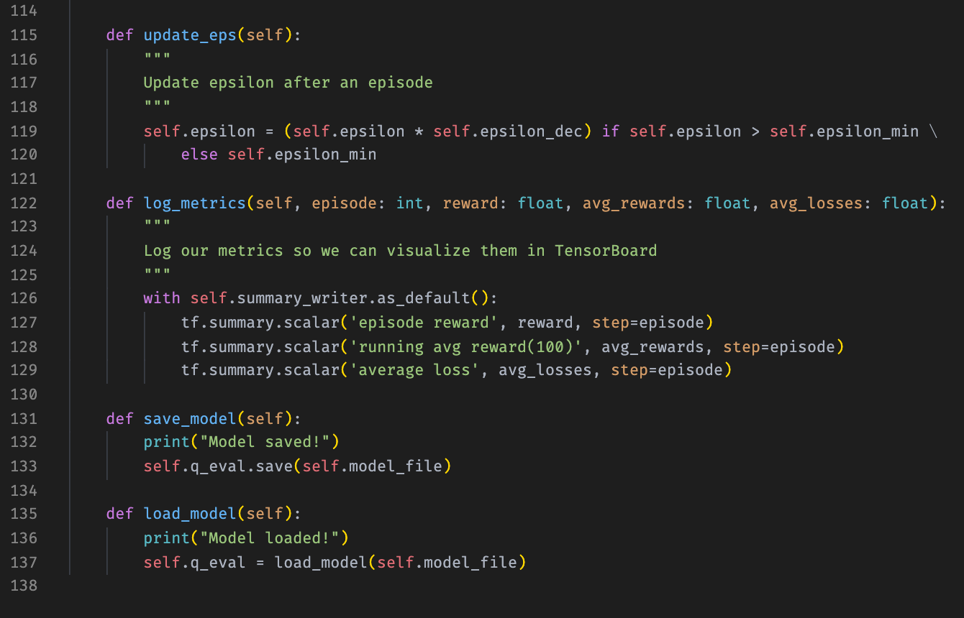
Lunar Lander — Agent
The rest of our agent class’s methods are utilities, mostly, but the epsilon annealing method is worth noting.
There are a number of ways you can gradually diminish the epsilon value, but here we chose to multiply by a constant less than one.
Note also the choose action method, which shows how epsilon impacts action choice.
Epsilon, in other words, is a value between zero and one that represents the probability that the agent will choose an action at random.
When we start, it’s near one, but by the end, it should be close to zero.

Slide 21
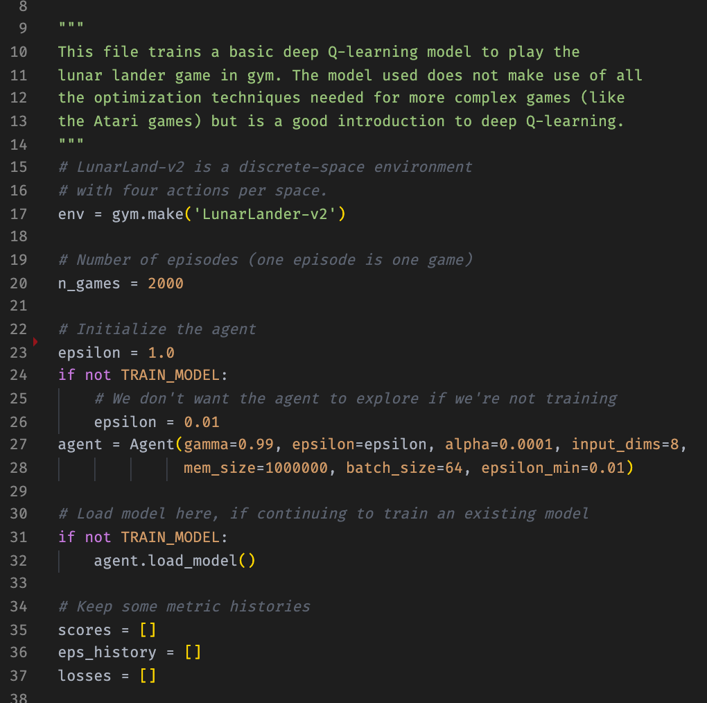
Lunar Lander — Train/Test Script
Finally, there’s the script that trains and tests the agent.
Note here our header, before the main training loop — we define all of our training parameters here, and control whether we’re training or testing a model with a flag.
Additionally, we keep some metric histories for logging later.
You can see our epsilon strategy here as well, starting with a 100% chance of exploring and ending with a 1% chance to explore. The diminishing factor is very low.
Our discount rate is also very high, at .99

Slide 22
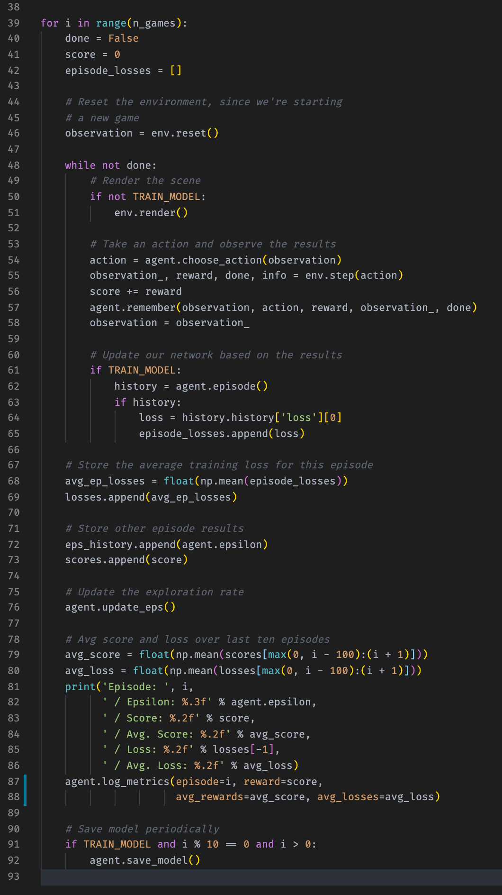
Lunar Lander — Train/Test Script
And here’s the main training loop. Nothing should really come as a surprise here.
This main loop contains our agent’s action-choice logic and the logging of all the results of the agent’s actions.
Each episode is a “game,” finished when the agent returns a done flag from an action.
We repeat the process for n number of games.
Remember that the episode method on our agent is where we perform all of the training logic, so our flag can toggle it on and off.
Finally, on line 76 we update the explore-exploit hyperparameter.
We’d like our average loss to go down over time, but our primary success metric is the average score. “Success” for Lunar Lander is a score over 200.

Slide 23
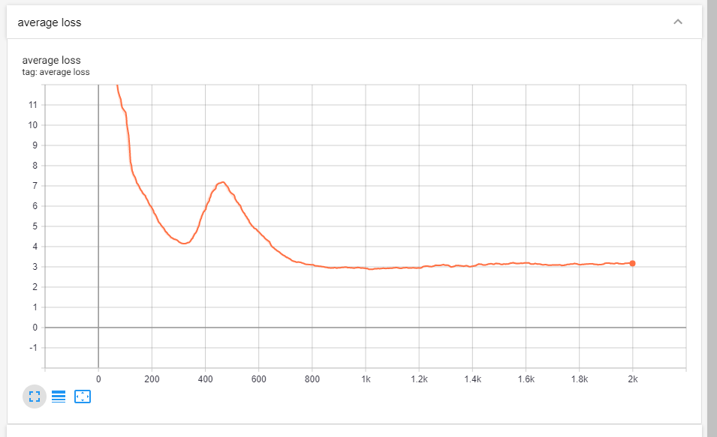
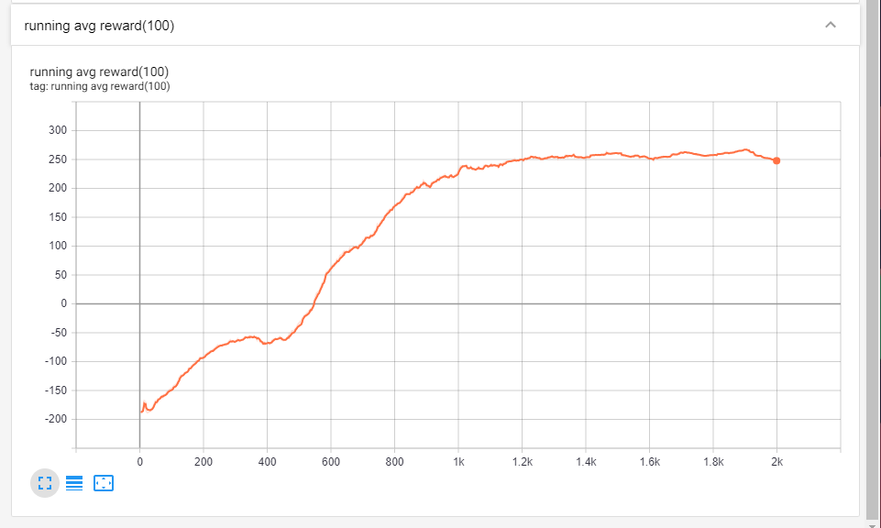
Lunar Lander — Wrap-Up
That’s it for the Lunar Lander agent! The conceptual overhead involved in building reinforcement learning models may seem overwhelming, but ultimately not very much code is required.
After a couple of thousand games, training along the way, we can see that our average loss has decreased precipitously and our average reward has far surpassed the “solved” state of +200.
The big spike in loss, around game 500, is interesting to note — it indicates that the model found a local reward maximum and then, after further exploration, found a better strategy.
We can see that after about 1,400 games the model more-or-less ceases to improve.

Slide 24
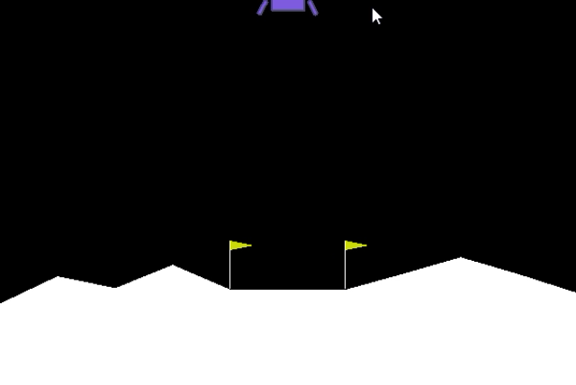
Lunar Lander — Wrap Up
<GIF of agent here>

Slide 25
Breakpoint — Dueling DQNs
To be continued…
But really, time permitting, it would be great to show the Breakpoint agent and how it uses a modified, convolutional DQN to achieve strong results on a more difficult task than the Lunar Lander.
The issue is: training time for the Breakpoint agent is over 72 hours now (on a single RTX 2080Ti), so this problem is hard to explore without more resources or more clever optimization.

Slide 26
YouTube URLs, Last Page
Two minute (short): https://youtu.be/uRGm31GNAeI
15 minutes (long): https://youtu.be/e_-41WNVh4I
@Travis Smith

